Slide 1

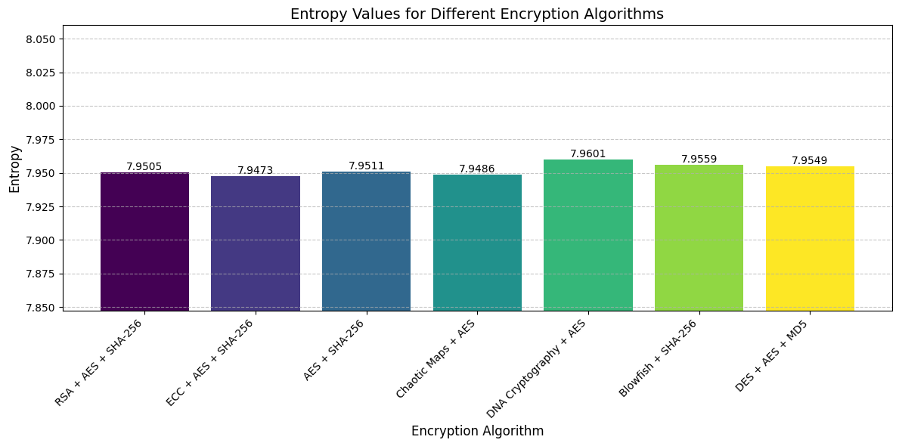
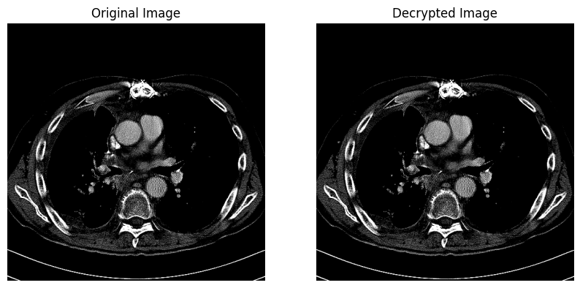
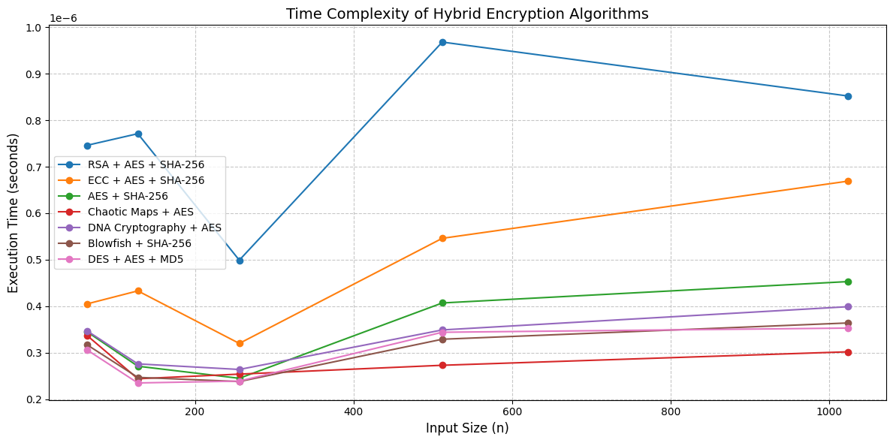
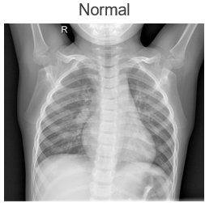
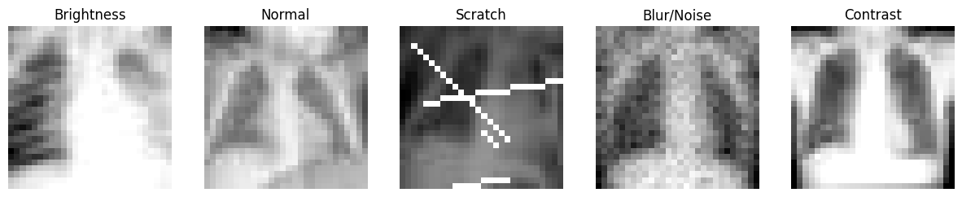
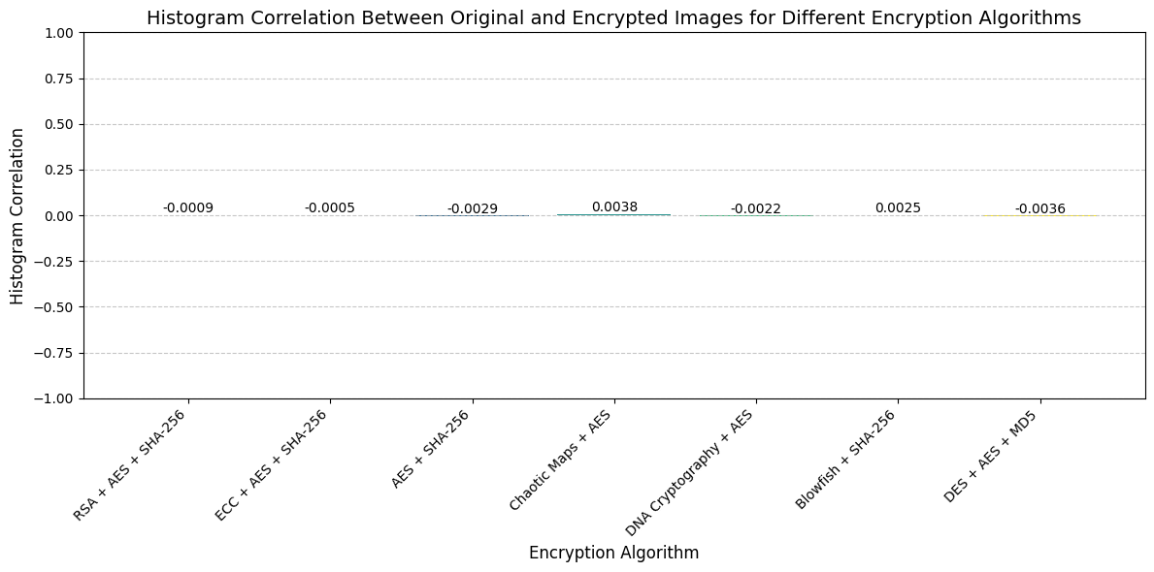
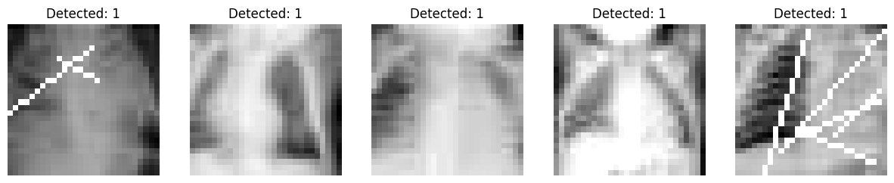
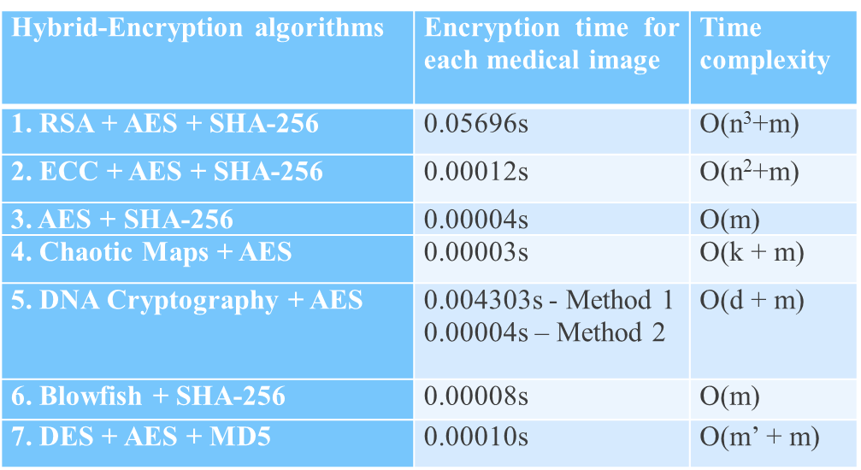
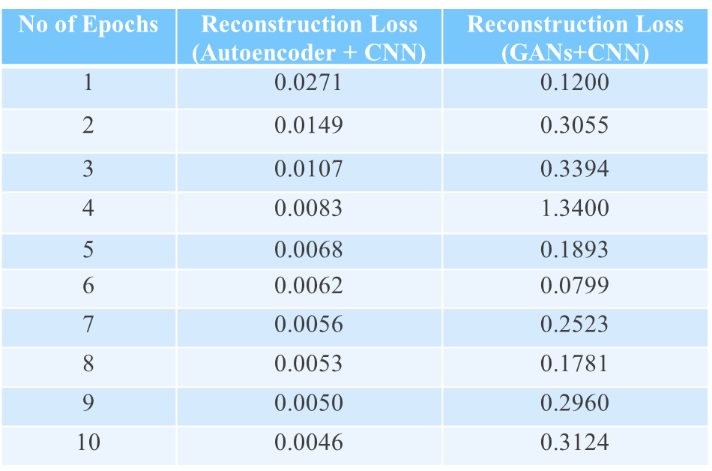
Medical Image Security and Anomaly Detection
Domain: Healthcare and Cohort: Cybersecurity
S.R. Vidhyambika
ABSTRACT
BACKGROUND OF THE STUDY
DESIGN/PROPOSED SYSTEM
RESULTS
With the growing reliance on digital healthcare, securing medical images is vital to protect patient privacy, trust and prevent data tampering.
This project presents hybrid cryptographic algorithms: RSA +AES+SHA-256, ECC+AES+ SHA-256, AES+SHA-256, Chaotic Maps+AES, Blowfish+SHA-256, DNA Cryptography+ AES (Mtd 1 & 2), and DES+AES+ MD5 for medical image security.
All algorithms were assessed using metrics & achieved MSE=0, SSIM=1, entropy>7, edge preservation=1, PSNR=∞, histogram correlation <0.00 encryption <1ms—ensuring robust security, image quality, & minimal encryption time for real-time telemedicine.
An ensemble of CNN-based Autoencoders & GANs detects scratch, blur/noise, contrast, brightness anomalies, or normal to spot unauthorized alterations & transmission errors in real-time.
Medical images like X-rays and MRIs are vital for diagnosis but contain sensitive data, making them prone to breaches and tampering that compromise patient privacy & care.
Significance: Securing these images ensures diagnostic integrity and compliance with HIPAA/GDPR. ML/DL methods enable real-time anomaly and tamper detection.
Gap identified: Existing solutions focus solely on either encryption or anomaly detection, lacking a unified framework. Many are also resource-intensive and yield low entropy. This project integrates hybrid encryption with AI-driven anomaly detection to boost security and reliability.
Datasets used: 2D Chest CT scans from the Cancer Imaging Archive and 2D Pneumonia Chest X-rays from Kaggle and MedMNIST’s Pneumonia-MNIST datasets were used, with images in DICOM/JPEG formats stored as .npz files. In the combined Kaggle + MedMNIST set, images were labeled into 5 classes—normal and 4 anomaly types: scratch, blur/noise, contrast, and brightness. Natural anomalies were manually labeled, while synthetic ones were added to a few images to balance all categories.
1. Medical image datasets are collected, pre-processed, labelled and stored.
2. Seven hybrid algorithms—RSA+AES+ SHA-256, Chaotic Maps+AES, Blowfish+ SHA-256, ECC+AES+SHA-256, DES+AES+ MD5, DNA Cryptography+AES (Mtd 1 & 2) and AES+ SHA-256, are implemented to enhance security, speed, accuracy and resilience against attacks.
3. Ensemble deep learning models—Autoencoder+CNN and GAN+CNN—are trained & tested to classify anomalies.
INTERPRETATIONS/DISCUSSIONS
Entropy: DNA Cryptography+AES (Mtd 2) shows the highest entropy.
Time: RSA and ECC combinations take the most time, while Blowfish, DNA (1 & 2), and Chaotic methods are fastest.
Histogram Correlation: All hybrid algorithms achieve values close to 0, effectively hiding image patterns, relations and ensuring strong security.
Reconstruction Loss: Normal images show near 0 loss, meaning models exactly recreate non-anomalous inputs. Anomalous images have more loss from replicating complex distortions.
OBJECTIVE OF THE PROJECT
Confidentiality: Protects patient data from unauthorized access, ensuring privacy.
Integrity: Maintains image accuracy and prevents tampering.
Authenticity: Verifies the source and integrity of medical images.
Reliability: Guarantees consistent image availability.
Anomaly Detection: Detects unauthorized changes for security.
EXISTING SYSTEM
Watermarking (spatial / frequency domains), steganography (using random cover images), weak encryption (e.g., DES), and hashing are vulnerable to cryptanalysis and brute force attacks.
These methods can cause visible artifacts, low PSNR, overfitting, and distortion, compromising security and diagnostic accuracy.
FUTURE WORK
Develop lightweight, robust hybrid encryption methods for 3D medical images, addressing data handling, structural, and security challenges in healthcare solutions.
Boost anomaly detection to cover diverse distortions imaging modalities with better accuracy.
SDG GOALS ADDRESSED:
Goal 3: Good Health and Well-being
Goal 9: Industry, Innovation, and Infrastructure

